Slide 1
Bi-Directional A*
Group 21:
Haoyang Zhang
Dhruvin Patel
Deep Pandya

Slide 2

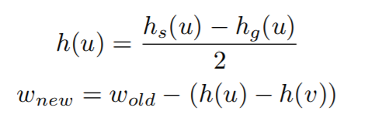
The Algorithm
Input start, goal and graph vertices, edge weights, heuristics on each vertex
Calculate modified edge weights and balanced heuristics using formula:
Run Dijsktra’s on the resultant graph from both start node and goal node
The point where the paths of both start node and goal node meet is end point of algorithm and trace the final path which is concatenation of both paths

Slide 3
Data Structures and Constraints
Data Structures:
Python Dictionary
Priority Queue
Constraints:
If there are no weights specified by the user, then the default value of the edge weight is
If the start node or the goal node is not specified by the user, then an error is displayed prompting user to enter either or both of the start node and goal node
If the path from the start node to goal node doesn’t exist, then a warning is displayed prompting the user that no path exists

Slide 4

The System
Input the desired graph using appropriate buttons for vertex, edge, start node, goal node and edit if required
Click the Confirm button to enable the BDA* button which was previously disabled
Click the BDA* button once it is enabled to run the algorithm on the graph
The Algorithm is run step by step on the graph and corresponding result is shown on the GUI

Slide 5
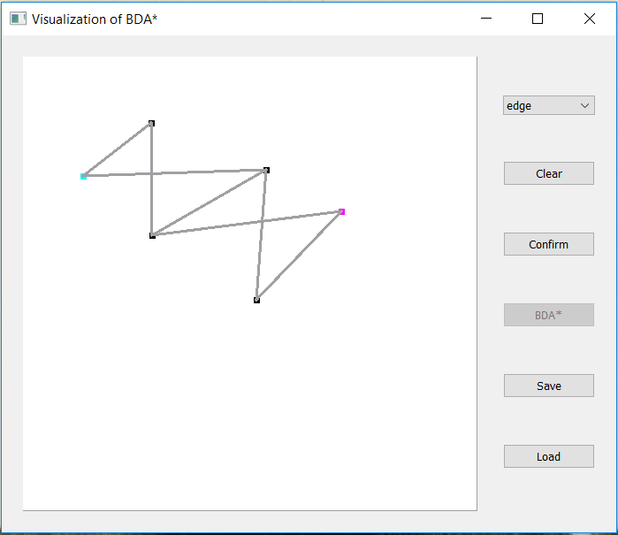
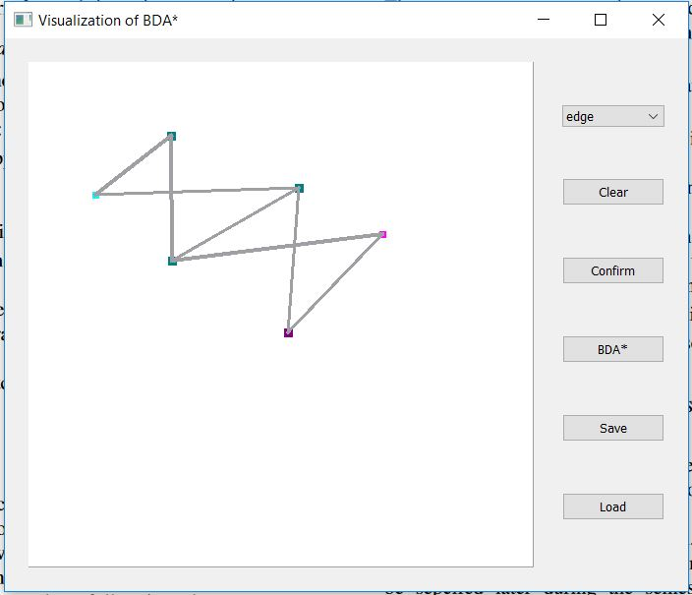
The GUI
Sample Graph drawn on GUI
Results of BDA* on graph. (Cyan color shows vertices explored from the start node; magenta color shows vertices explored from goal node; final path is highlighted to be thicker than rest of the edges)

Slide 6
Real World Applications
Academics: A teacher will show a sample graph and render the algorithm on that graph to show the students the logic behind BiDirectional A* algorithm. The application developed for this project will demonstrate how the algorithm works. A student may ask to change the graph a little and observe the impact of change on the algorithm.
Input: The graph in a pkl format or can draw a graph
Output: Visualization of each step of BDA* along with the path
Researcher: The researcher inputs a graph for which they have performed other search algorithms and will compare them to the result of our application. The researcher will know each step and thus can make improvements for the research purposes.
Input: The graph in pkl format or can draw a graph
Output: Visualization of each step of BDA* along with the path

Slide 7
References
https://en.wikipedia.org/wiki/Bidirectional_search
https://en.wikipedia.org/wiki/A*_search_algorithm

Slide 8
Thank You

